Slide 1


Slide 2
EdTech Websites
This resource contains a collection of Educational Technology Websites divided into categories
Links to lessons for how to use each of the websites are located at the bottom of each of the slides
These websites can be used to allow you or your students to create Presentations, Blogs, Mind Maps, Videos, Comics, Websites and a whole lot more…

Slide 3
Table of Contents
TOPIC | WEBSITES
Presentations | Prezi, Haiku Deck
Multi-Media Posters | Glogster
Blogs | Kidblog
Mind Maps | Popplet, Slatebox
Online Response System | Kahoot
Comics | Bitstrips, ComicMaster, Comic Life
Writing | Storybird
Photo Editing | PicMonkey
Surveys | Survey Monkey
Electronic Badges | Classbadges
Classroom Management | ClassDojo
Multi Media Wall | Padlet
Online Whiteboard | Mural.ly
Collaboration/Social Network | Edmodo
Animated Video | GoAnimate, Powtoon, Dvolver
Video | Animoto, MovieMaker, TubeChop, WeVideo
Google Drive
Microsoft Office 2010
Microsoft Office 2013
Infographics | Piktochart
Websites | Weebly, Wix

Slide 4

Prezi.com
Presentations
Link to lesson
http://www.teacherspayteachers.com/Product/Prezi-Lesson-Activity-Prezicom-944114

Slide 5

Presentations
Haikudeck.com
Link to lesson
http://www.teacherspayteachers.com/Product/Haiku-Deck-Presentation-Software-Tutorial-1234418

Slide 6
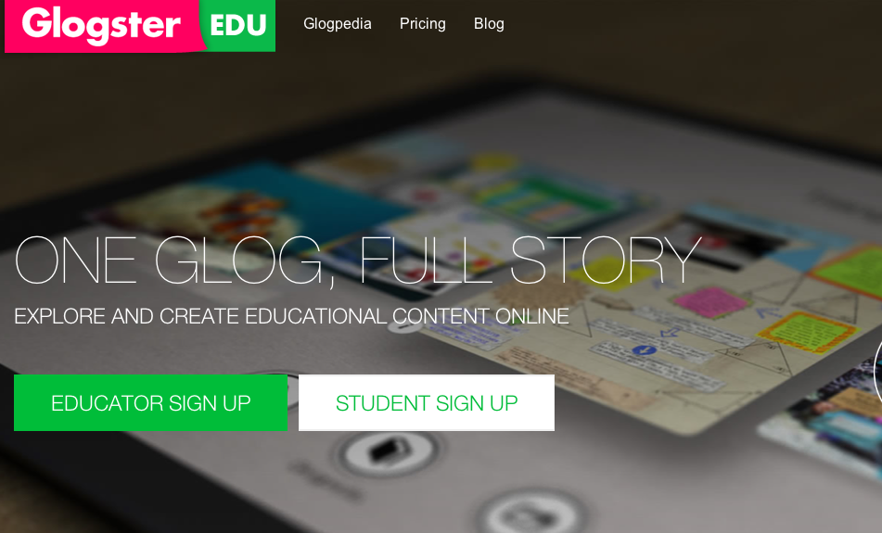
Multi-Media Posters
Glogster.com
Link to lesson
http://www.teacherspayteachers.com/Product/Glogster-Interactive-Multimedia-Poster-Lesson-943480

Slide 7

Kidblog.org
Blogs
Link to lesson
http://www.teacherspayteachers.com/Product/Blog-Lesson-Kidblogorg-Blogging-1322863

Slide 8
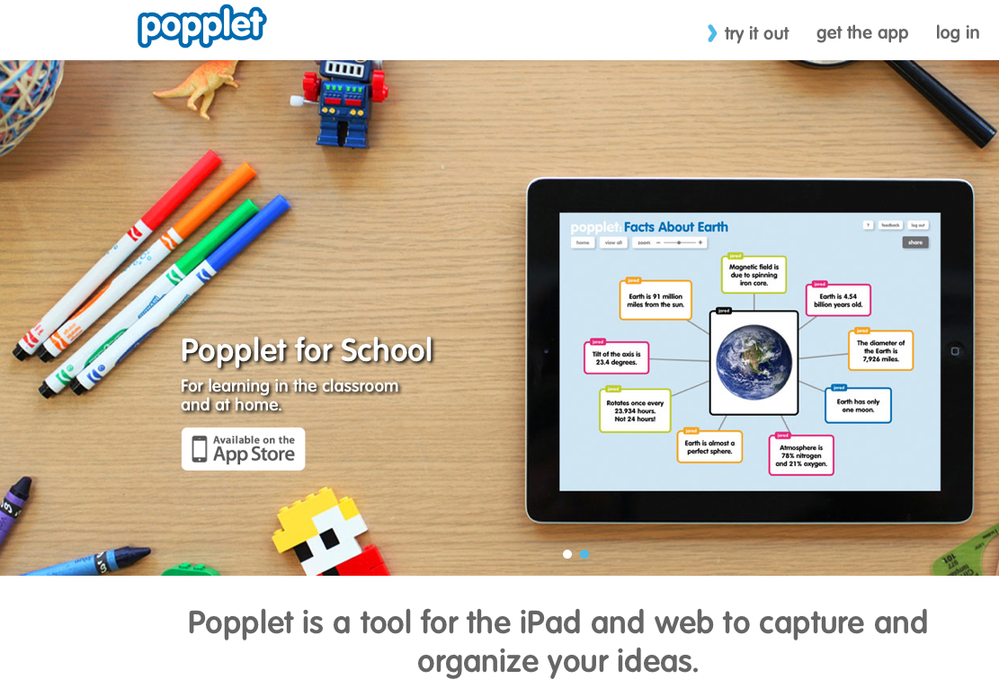
Mind Maps
Popplet.com
Link to lesson
http://www.teacherspayteachers.com/Product/Popplet-Mind-Map-Lesson-Poppletcom-1153598

Slide 9
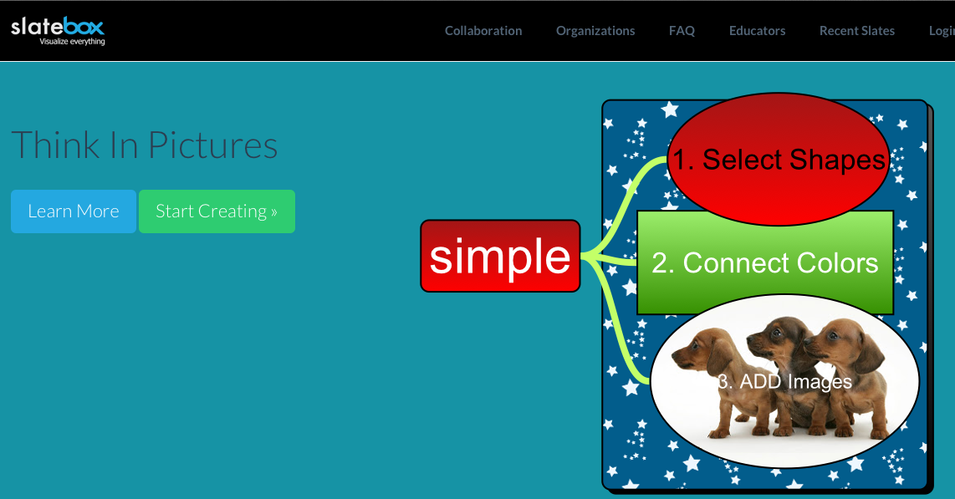
Mind Maps
Slatebox.com
Link to lesson
http://www.teacherspayteachers.com/Product/Slatebox-Mindmap-Lesson-Share-Connect-Ideas-Slateboxcom-1327709

Slide 10

Response System
Getkahoot.com
Link to lesson
http://www.teacherspayteachers.com/Product/Kahoot-Game-Based-Learning-Classroom-Response-System-Lesson-1323928

Slide 11
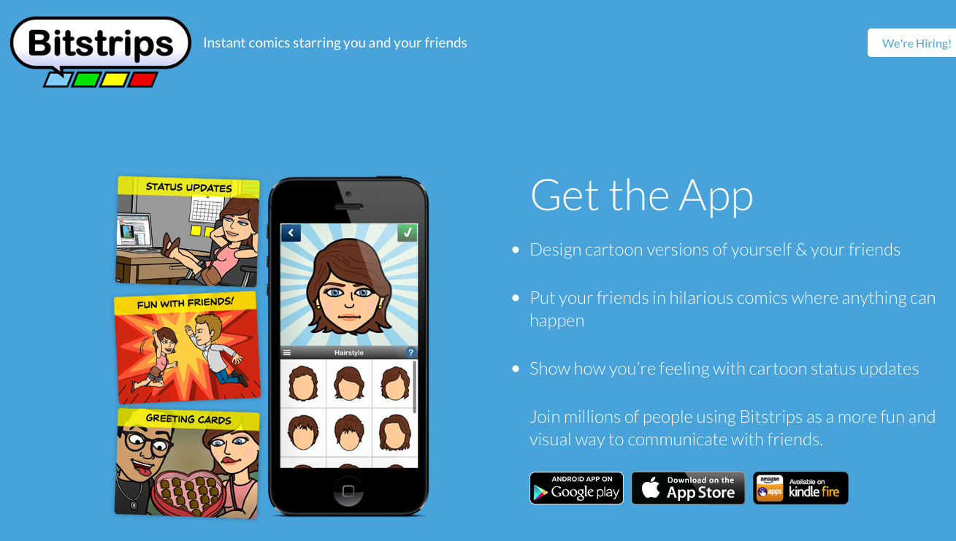
Comics
Bitstrips.com
Link to lesson
http://www.teacherspayteachers.com/Product/Bitstrips-Create-Comics-Lesson-Activity-Bitstripscom-1138107

Slide 12

Comics
Comiclife.com
Link to lesson
http://www.teacherspayteachers.com/Product/Comic-Life-Create-Comics-Lesson-Activity-1148369

Slide 13

Writing
Storybird.com
A new literacy tool for a new generation
Inspire students to write and read better, and more often
Beautiful art inspires students and jumpstarts their writing
Link to lesson
http://www.teacherspayteachers.com/Product/Storybird-Digital-Picture-Book-Lesson-1140297

Slide 14

Photo Editing
Picmonkey.com
Link to lesson
http://www.teacherspayteachers.com/Product/PicMonkey-Photo-Editing-Lesson-Activity-PicMonkeycom-1158196

Slide 15
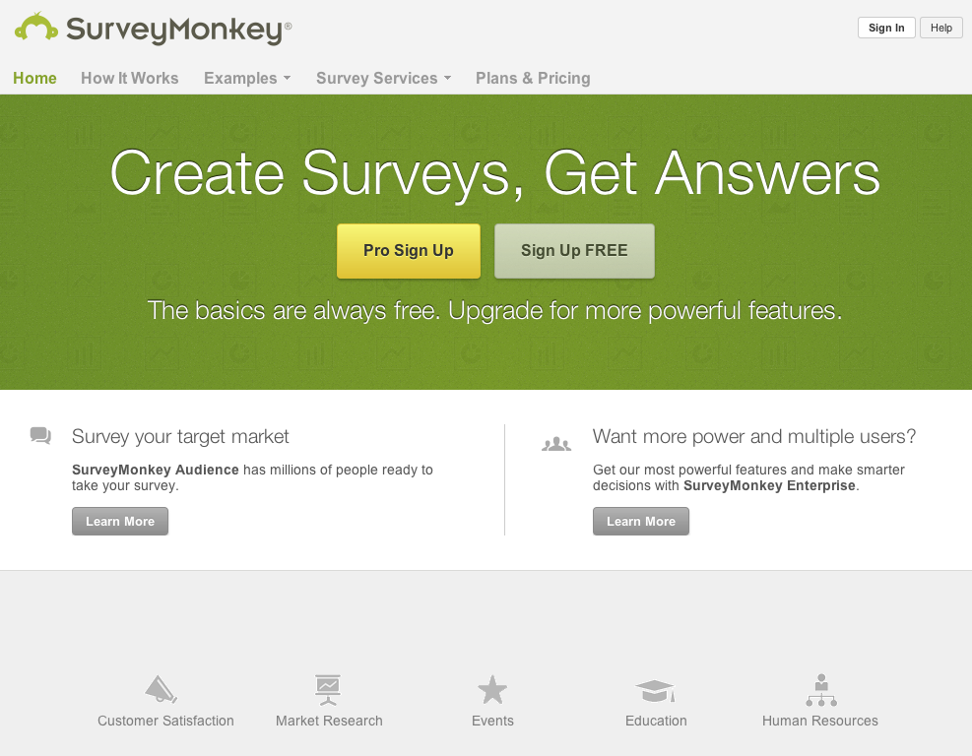
Surveymonkey.com
Surveys
Link to lesson
http://www.teacherspayteachers.com/Product/SurveyMonkey-Create-Electronic-Surveys-Lesson-1191801

Slide 16
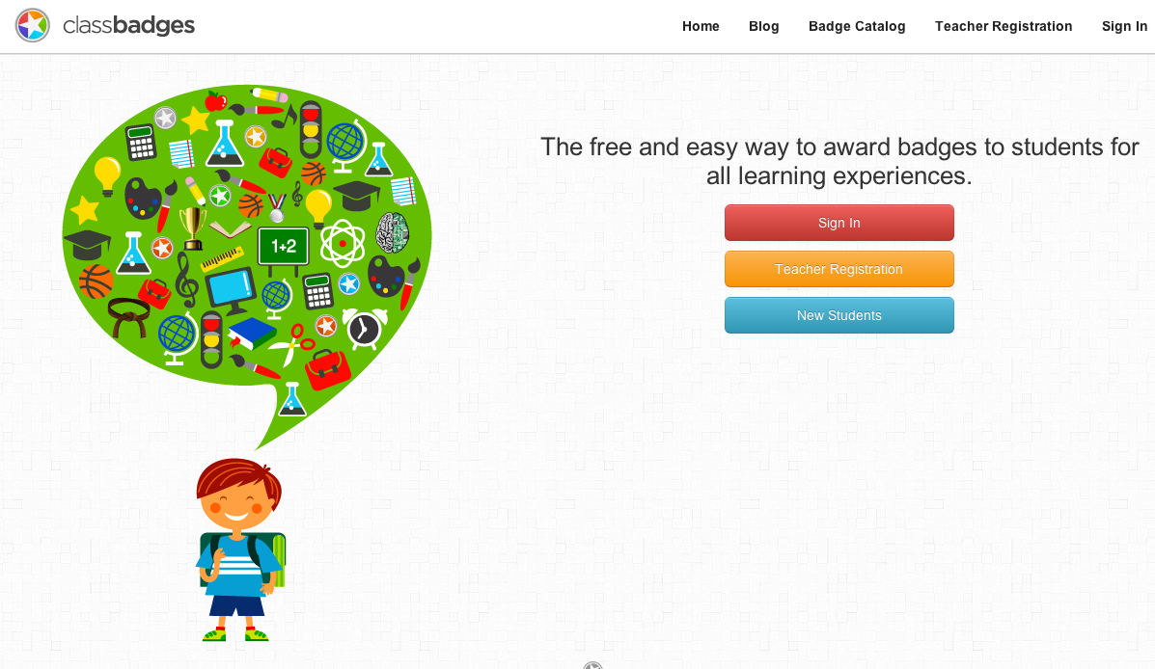
Electronic Badges
Classbadges.com
Link to lesson
http://www.teacherspayteachers.com/Product/ClassBadges-Online-Tool-Award-Student-Badges-1182778

Slide 17
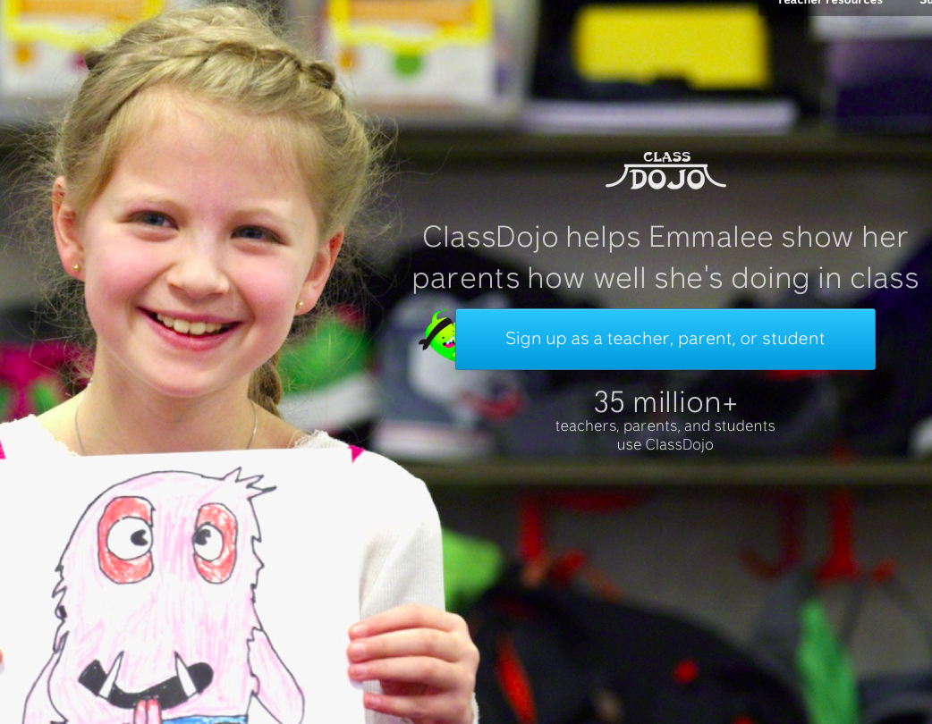
Classroom Management
Classdojo.com
Link to lesson
http://www.teacherspayteachers.com/Product/ClassDojo-Behavior-Management-Tool-Lesson-1191776

Slide 18
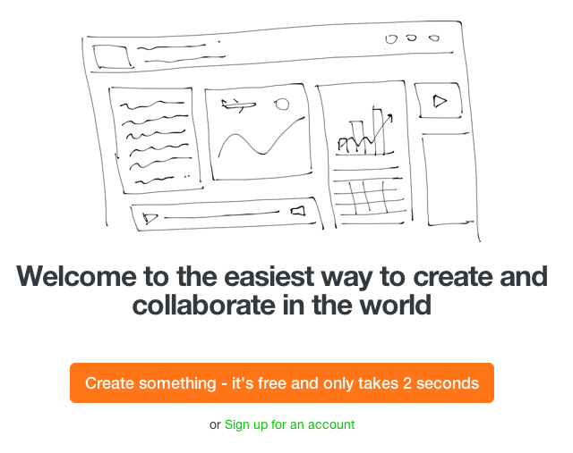
Multi-Media Wall
Padlet.com
Link to lesson
http://www.teacherspayteachers.com/Product/Padlet-Interactive-Multi-Media-Wall-Lesson-1231850

Slide 19

Online Whiteboard
Mural.ly
Link to lesson
http://www.teacherspayteachers.com/Product/Murally-Online-Whiteboard-Lesson-1232845

Slide 20
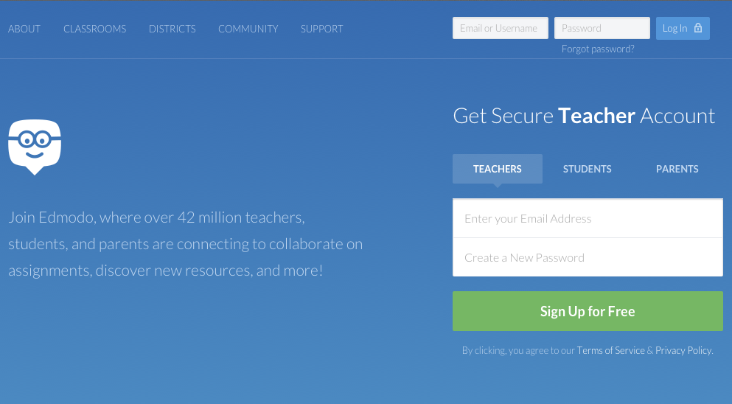
Collaboration
Edmodo.com
Link to lesson
http://www.teacherspayteachers.com/Product/Edmodo-Lesson-Virtual-Learning-Environment-Edmodocom-1189076

Slide 21
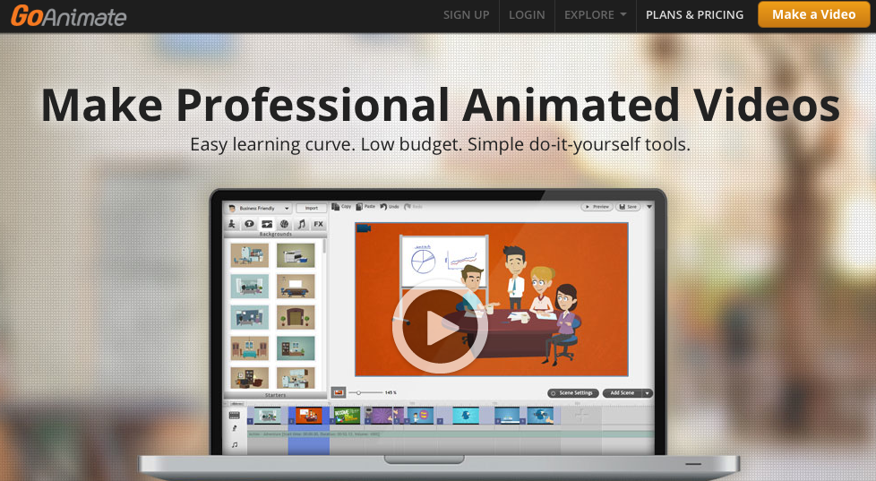
Animated Video
Goanimate.com
Link to lesson
http://www.teacherspayteachers.com/Product/Animated-Movies-Lesson-Activity-GoAnimatecom-GoAnimate-991223

Slide 22
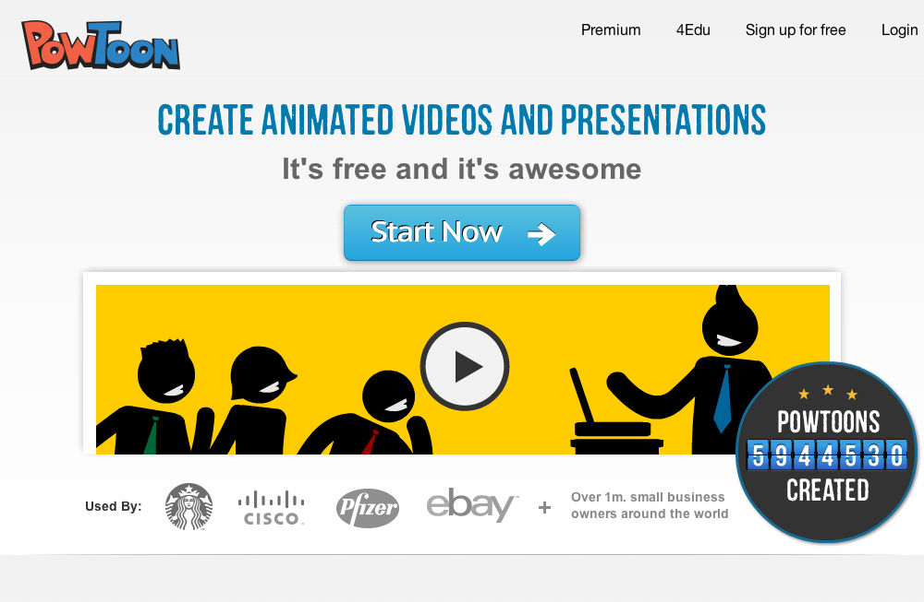
Animated Videos
Powtoon.com
Link to lesson
http://www.teacherspayteachers.com/Product/Powtoon-Animated-Presentations-Lesson-1139418

Slide 23
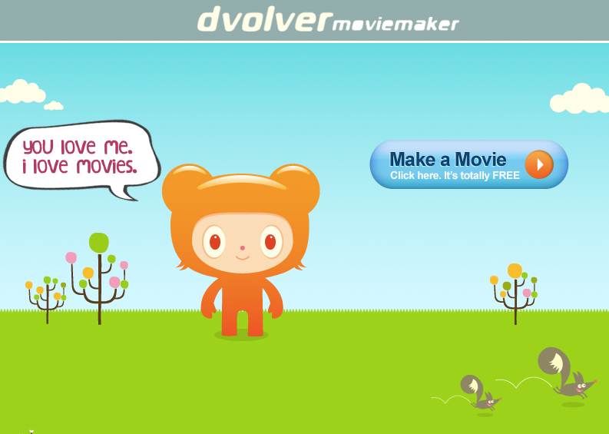
Dvolver.com
Animated Video
Link to lesson
http://www.teacherspayteachers.com/Product/Dvolver-Animated-Video-Tutorial-1160862

Slide 24
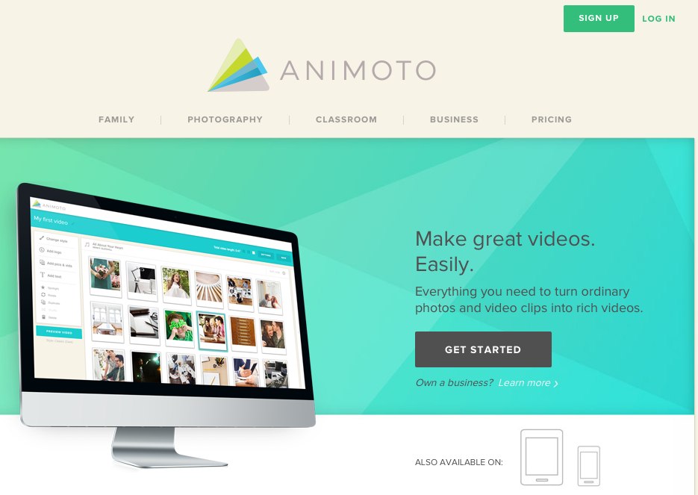
Video
Animoto.com
Link to lesson
http://www.teacherspayteachers.com/Product/Animoto-Online-Video-Lesson-1142053

Slide 25
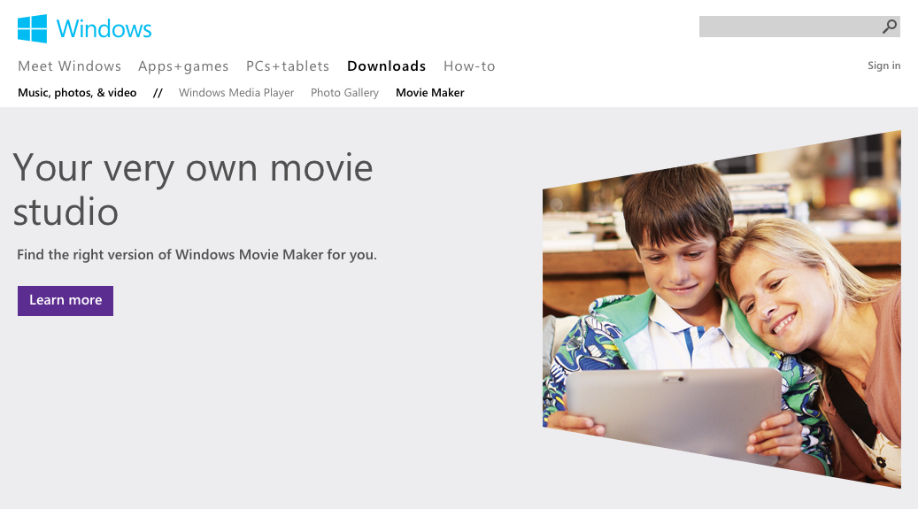
Video
Movie Maker
Link to lesson
http://www.teacherspayteachers.com/Product/Movie-Maker-Lesson-1050585

Slide 26
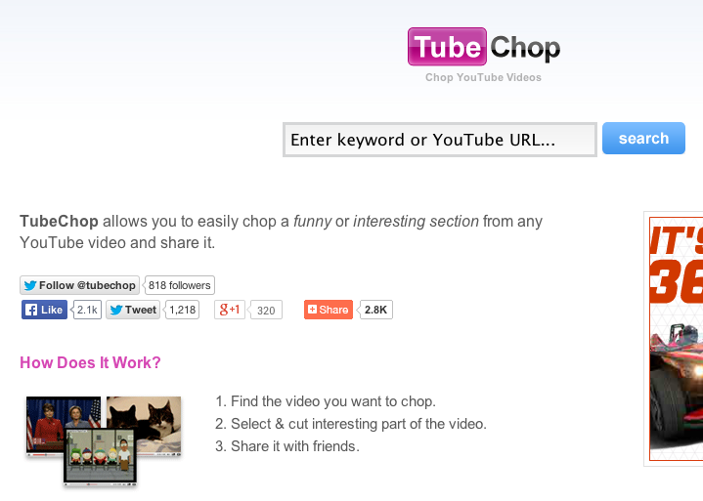
Video
Tubechop.com
Link to lesson
http://www.teacherspayteachers.com/Product/TubeChopcom-Tutorial-Chop-a-YouTube-Video-1228954

Slide 27
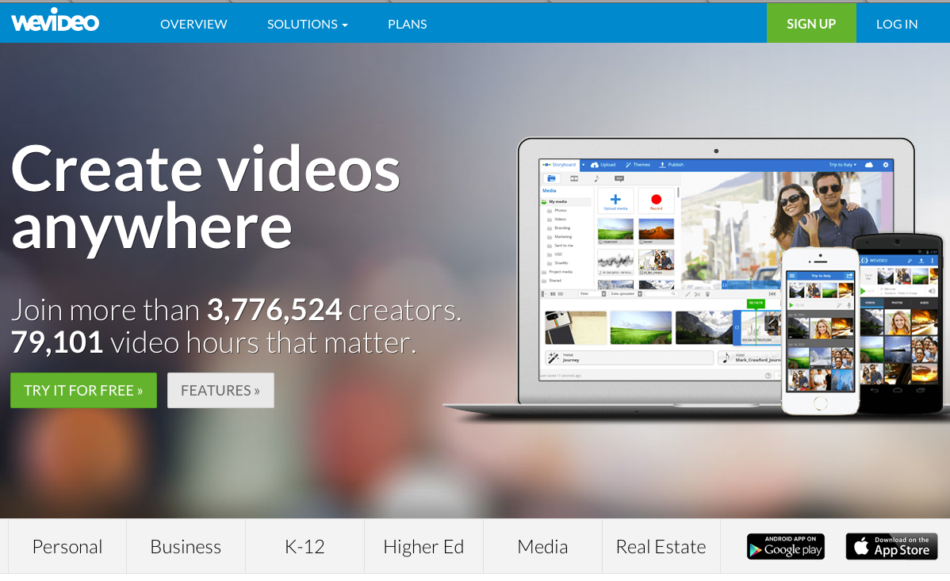
WeVideo
Video
Link to lesson
http://www.teacherspayteachers.com/Product/Google-Drive-Lesson-Updates-Add-Ons-2014-1333917

Slide 28
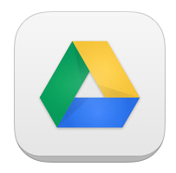
Google Drive
Link to lesson
http://www.teacherspayteachers.com/Product/Google-Drive-Docs-Lessons-Bundle-1065881

Slide 29
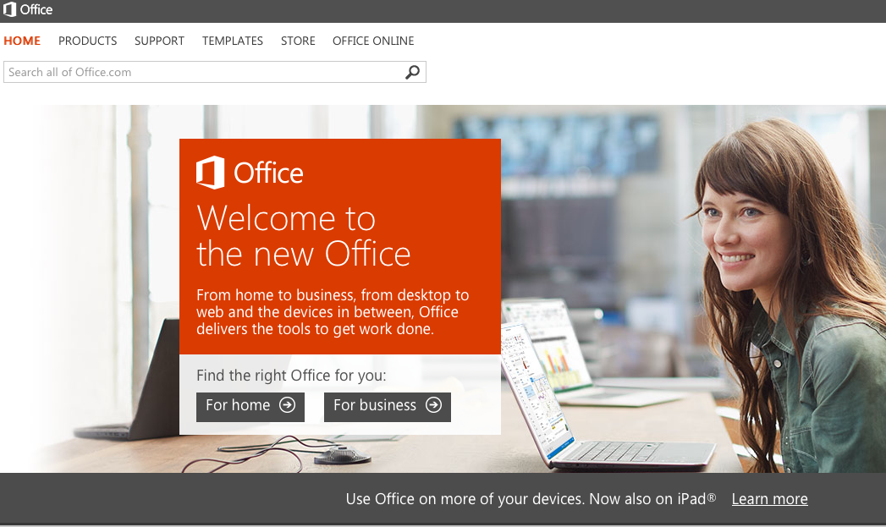
Microsoft Office 2010
Link to lesson
http://www.teacherspayteachers.com/Product/Microsoft-Office-2010-Bundle-1434953

Slide 30
Microsoft Office 2013
Link to lesson
http://www.teacherspayteachers.com/Product/Microsoft-Office-2013-Bundle-1437620

Slide 31

Infographics
Piktochart.com
Link to lesson
http://www.teacherspayteachers.com/Product/Piktochart-Create-Infographics-Lesson-1196099

Slide 32
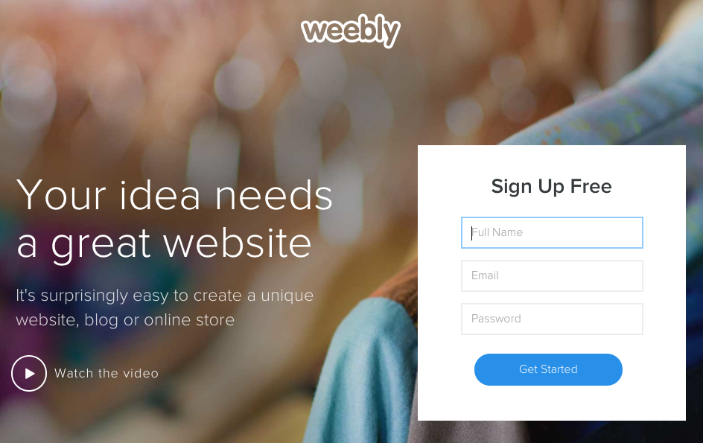
Weebly.com
Websites
Link to lesson
http://www.teacherspayteachers.com/Product/Weebly-Website-Builder-Lesson-Build-Create-Activity-1012181

Slide 33

Wix.com
Websites
Link to lesson
http://www.teacherspayteachers.com/Product/Wix-Website-Builder-Lesson-Build-Create-Activity-1238228

Slide 34

Specializing in PowerPoint presentations that share cutting edge technology and examine revolutionary businesses
Link to store
http://www.teacherspayteachers.com/Store/Gavin-Middleton

Slide 35
Thank you for downloading this PowerPoint
I hope that you and your students enjoyed it!
If you provide Positive Feedback and Follow Me, I will send you a Free Lesson of your choice ($4 or less value).
E-mail me at gavin@eastdalebusiness.com to receive your free PowerPoint.
To view or purchase more materials here is a link to my store
http://www.teacherspayteachers.com/store/gavin-middleton

